Slide 1
Iete hack off
ARWrite - Air writing using object based motion following and Image Processing
By Sartaj Singh Wariah
Aditya Rajesh Nair

Slide 2
Goal: Make Education Easy All Over The world

Slide 3
INTRODUCTION:-
Have you ever had a moment of inspiration but have nothing around you to write your idea down? Have you ever thought about making notes anywhere and anytime without a pen-paper and being able to project what you write to multiple screens for presentations?
We had the exact same thoughts during our recently concluded semester exams, which would have helped improved our preparation considerably.
Therefore we intend to create a solutions for the above by using a raspberry pi, a camera and python programming. It will help us quickly visualise what's in our heads. This concept could also be incorporated into our smart classes.

Slide 4
Proposed plan of action
Emulate writing in the air with smart glasses.
When you move your hand or pen, the camera will trace your movement and display whatever shape you create.
To build our prototype, we will use a Raspberry Pi, possible mounting it on our heads as a cap since we can't access actual smart glasses and display it on a monitor.
The movement will be recorded by using colour based object detection and tracking with OpenCV.

Slide 5
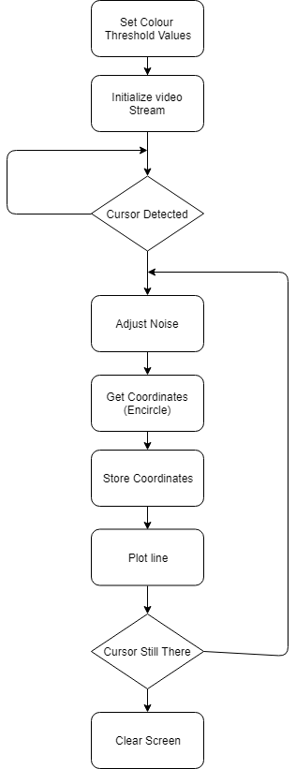
BLOCK Diagram

Slide 6
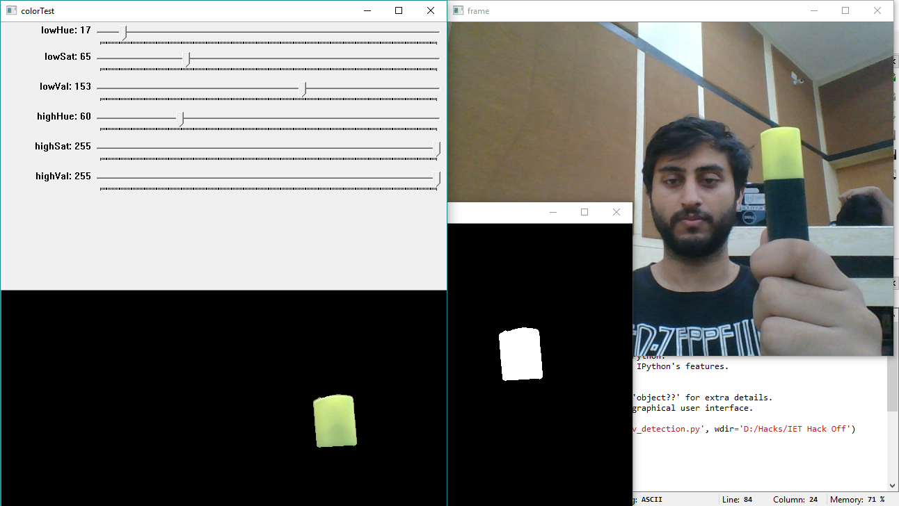

Slide 7
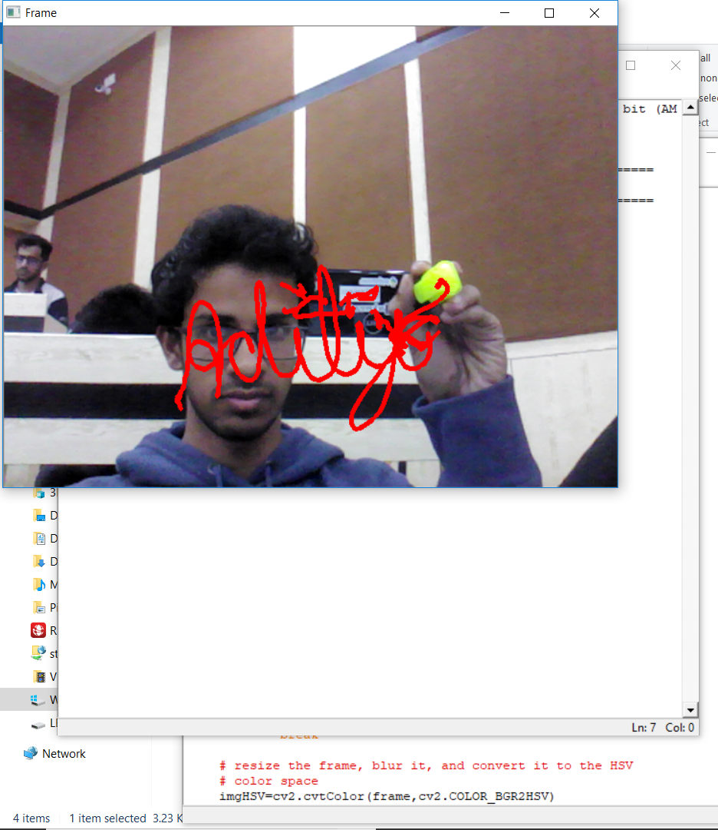

Slide 8
Future enhancements:-
We could improve this current technique by live streaming it through a pi cam and a raspberry pi or smart glasses to wirelessly and boardlessly project what we write straight onto your screens.
This can also be streamed into mobile phones which we will be looking to explore in the future. This will change the way presentations are made and learning is done.
We could also improve the versatility of the cursor/stylus to allow people to use even their fingers as a pen thus completely eliminating the need of paper,pens or even a physical screen.

Slide 9

Place your screenshot here
Android App
We will also create an app which will eliminate the need of the Raspberry Pi. It will also make the setup cheaper.
Smart ARWrite

Slide 10
thanks!
Any questions?

